Slide 1


Publication Ready Tables Through Coding

Slide 2
CCSS Research Support Code of Conduct
The Cornell Center for Social Sciences provides a welcoming environment for everyone embracing all backgrounds or identities. All instructors and attendees agree to abide by our community norms. We encourage the following behaviors in our workshops:
Respect differing viewpoints and ideas
Share your own perspectives and ask any questions
Accept constructive criticism
Use welcoming and inclusive language
Show courtesy and respect for all instructors and attendees
If you believe that an instructor or attendee has violated the code of conduct, please report the violation to CCSS-ResearchSupport@cornell.edu. We take all reported incidents seriously.

Slide 3
Land Acknowledgement
Cornell University is located on the traditional homelands of the Gayogo̱ hó꞉nǫ' (the Cayuga Nation). The Gayogo̱ hó꞉nǫ' are members of the Haudenosaunee Confederacy, an alliance of six sovereign Nations with a historic and contemporary presence on this land. The Confederacy precedes the establishment of Cornell University, New York state, and the United States of America. We acknowledge the painful history of Gayogo̱ hó꞉nǫ' dispossession, and honor the ongoing connection of Gayogo̱ hó꞉nǫ' people, past and present, to these lands and waters.
Here are additional links for more on the history of Cornell’s violent, colonial formation, the movement to return native lands, and about the AIISP program at Cornell.
Consider donating to the Gayogo̱ hó꞉nǫʼ sovereignty initiative here.

Slide 4
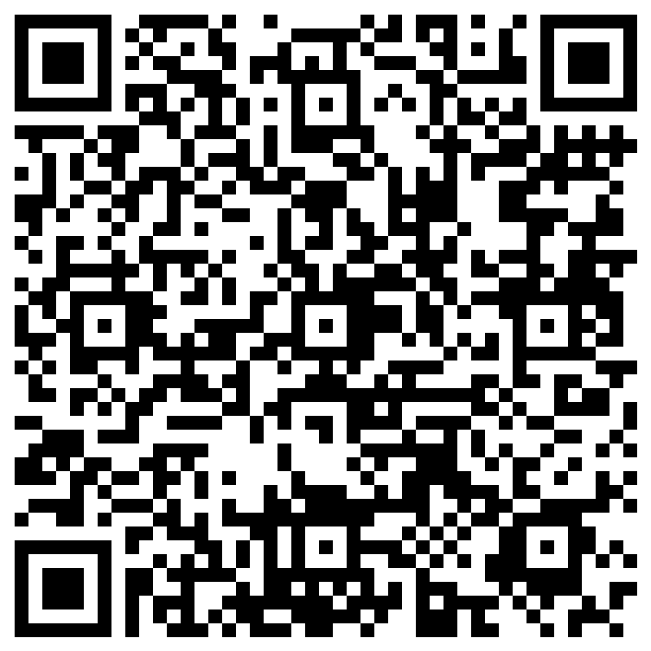
Attendance

Slide 5
Outline
Sample Replications
Exporting Results Through Coding Basics
Demo Sample Programs(R, SAS, Stata, SPSS, Python)
Exporting Results Through Coding Advanced
Demo Sample Programs(R, SAS, Stata, SPSS, Python)
Helpful Links.

Slide 6
R
Basic:
Sink command
png, ggsave
Advanced:
Packages(stargazer)
RMarkdown

Slide 7
SAS
Basic:
Save procedures as datasets and export
Advanced
ODS statements. Pdf, rtf, excel
Stylesheets

Slide 8
Stata
Basic:
Create summary dataset, export as excel
Graph export
Advanced:
Packages. Esttab, tabout
Putpdf. putexcel

Slide 9
SPSS
Not the best option for exporting ourput.
Output Export

Slide 10
Python
Link to code
https://colab.research.google.com/drive/1lBPO1enLlSEZjVpXLwPxvE_D5KVjZ299?usp=share_link
Packages: Tabulate, prettytable

Slide 11
Helpful Links
R:
https://towardsdatascience.com/create-flawless-tables-from-your-dataframe-ready-for-publication-7e3fe2d63a52
Python
https://blog.devgenius.io/how-to-easily-print-and-format-tables-in-python-18bbe2e59f5f
https://stackoverflow.com/questions/9535954/printing-lists-as-tabular-data\

Slide 12
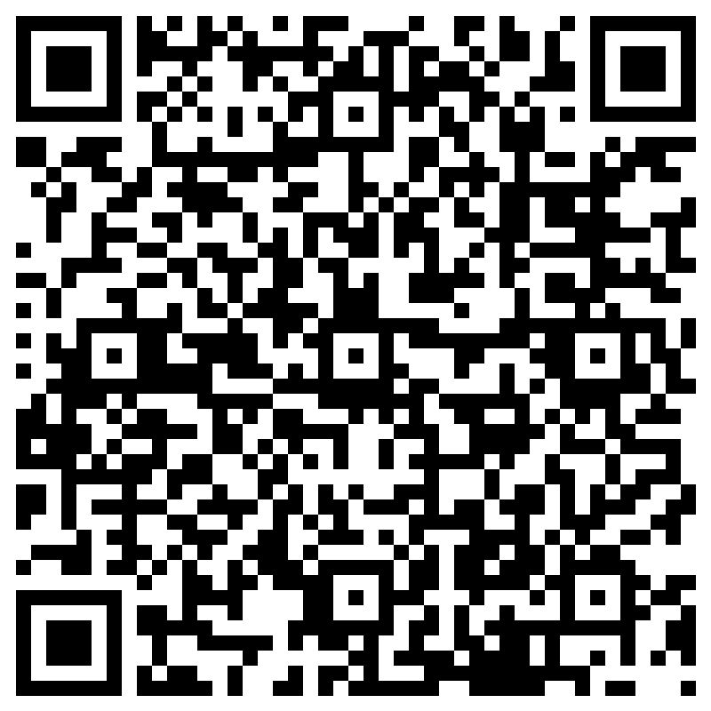
Evaluation

